Slide 1
Concurrency
Week 3
Threads

Slide 2
Topics
Recap: Concurrency / Parallelism, Processes
Threads
Process / Thread: Memory
Multi-threaded programs
Communication models

Slide 3
Parallelism vs. Concurrency
Recap...
Parallelism:
Use extra resources to
solve a problem faster
Concurrency:
Correctly and efficiently manage
access to shared resources
work
requests
resources
resource
These concepts are related but still different:
Common to use threads for both
If parallel computations need access to shared resources, then the concurrency needs to be managed

Slide 4
Concurrency
Recap...
Concurrency: Correctly and efficiently manage access to shared resources (from multiple possibly-simultaneous clients)
requests
resource

Slide 5



Concurrency Example: Shared Database
Recap...
A database is used for airline ticket reservation
Multiple sales agents may access the database simultaneously

Slide 6
What is a Process? (recap)
Recap...
Process – a program in execution; process execution must progress in sequential fashion
To put a program in execution we should:
Copy it (at least partially!) into the main memory
Set the program counter to point to the first instruction
Initialize stack
Reset flags
The process is ready, start running …

Slide 7
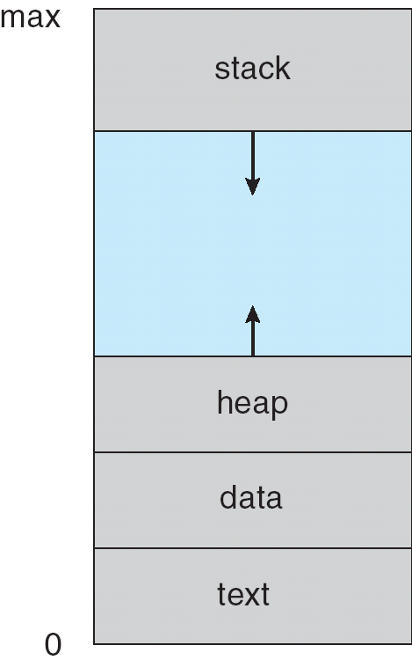
How a Program is Put in Execution?
Recap...
To put a program in execution we should:
Copy it (at least partially!!) into the main memory
Set the program counter to point to the first instruction
Initialize stack
Reset flags
The process is ready, start running …
Q: How does a process use heap and stack?

Slide 8
Independent tasks.
Recap...
Question: Can we specify independent tasks within a process?
We need a way to specify a set of program instructions from a larger code as an independent group of instructions

Slide 9
Threads

Slide 10
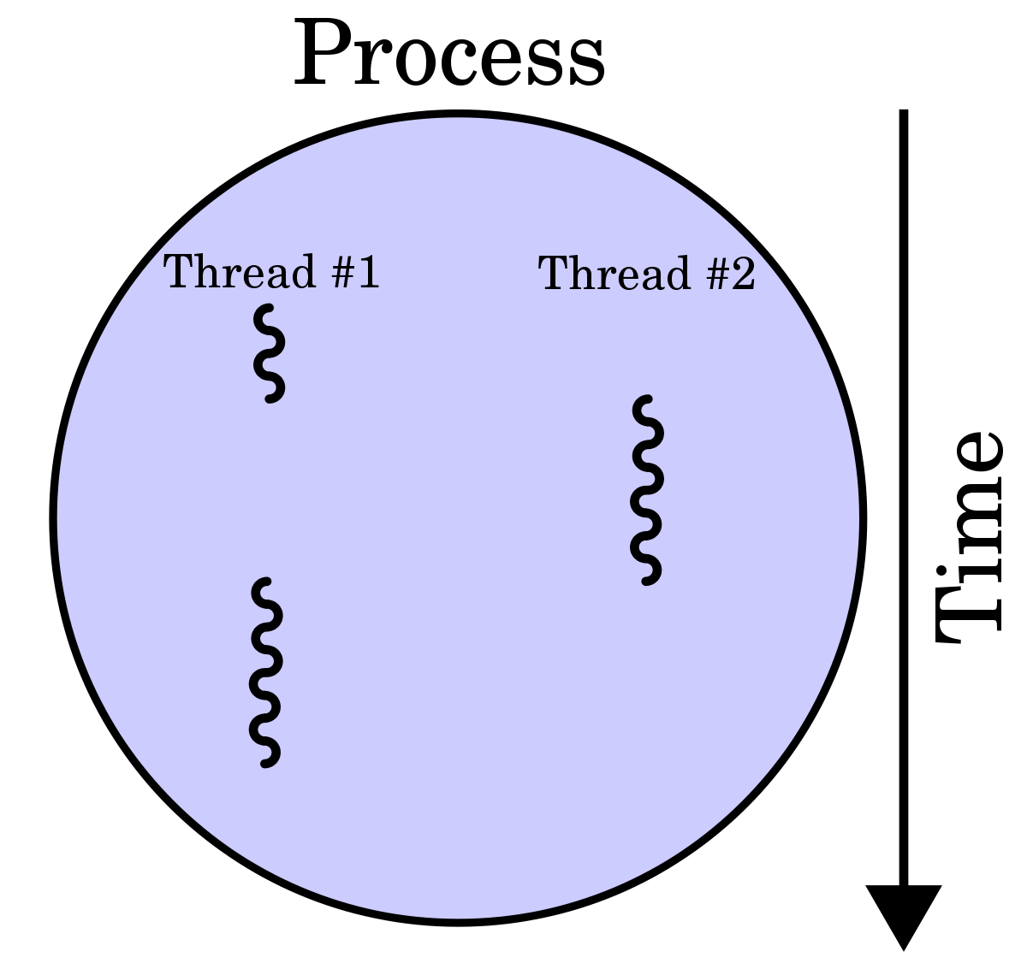
Threads
If the cooperating processes share information for computation speed-up or modularity, they can be part of the same process.
Being part of the same process makes it possible to
Share the code
Share the data
Share the resources

Slide 11
Threads
If the cooperating processes share information for computation speed-up or modularity, they can be part of the same process.
However each one should have its own
Stack
Registers
Program counter
Each sub-part of a process is named a thread
Watch here (https://www.youtube.com/watch?v=O3EyzlZxx3g).

Slide 12
Threads
A thread is a smallest set of instructions that can be executed independently.
A thread:
is an independent path of execution.
can be managed independently by the scheduler.
is a part of a process.
has lighter state information (compare it with PCB).
has cheaper context switching.
Notes:
pcb: process control block

Slide 13
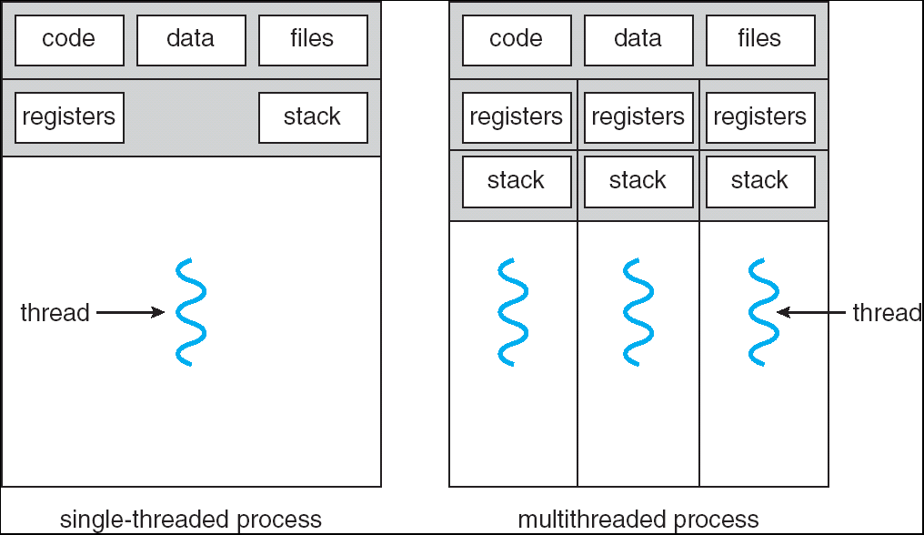
Single and Multithreaded Processes
Benefits of Multithreading
Responsiveness
Easy Resource Sharing
Economy
(possible) Utilization of Multi-processor Architectures

Slide 14
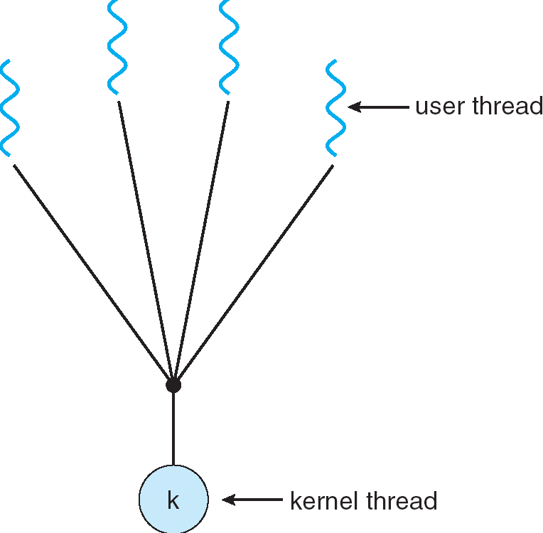
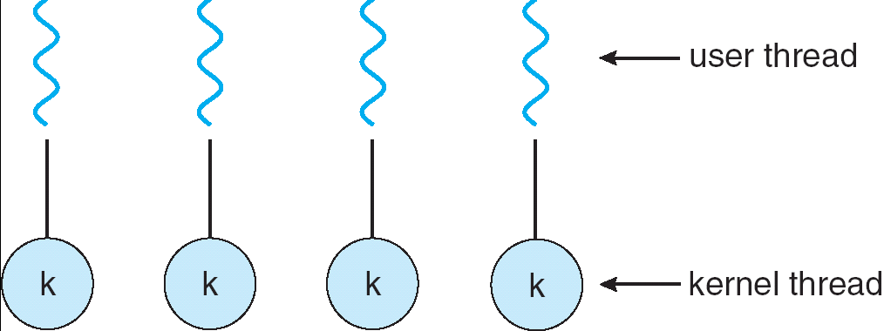
Multithreading Models
Many-to-One
Many user-level threads mapped to single kernel thread
Examples:
Solaris Green Threads
Portable Threads (PThreads)
One-to-One
Each user-level thread maps to kernel thread
Examples
Windows NT/XP/2000
Linux
Solaris 9 and later

Slide 15
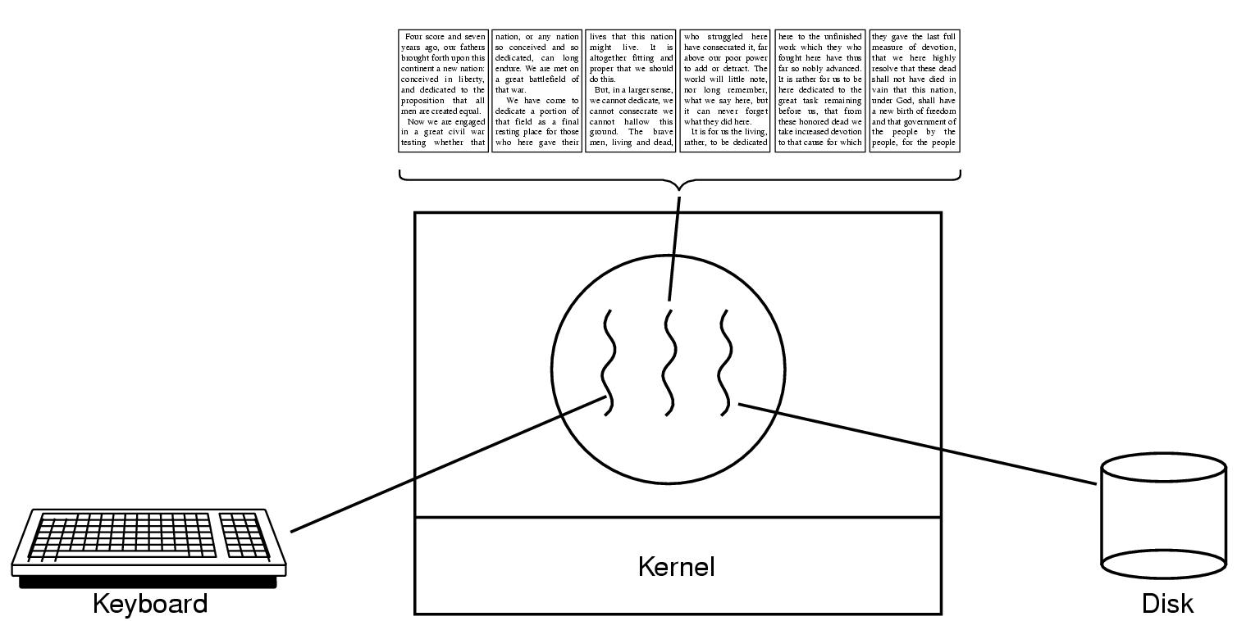
Thread Usage Example (1)
A word processor with three threads

Slide 16
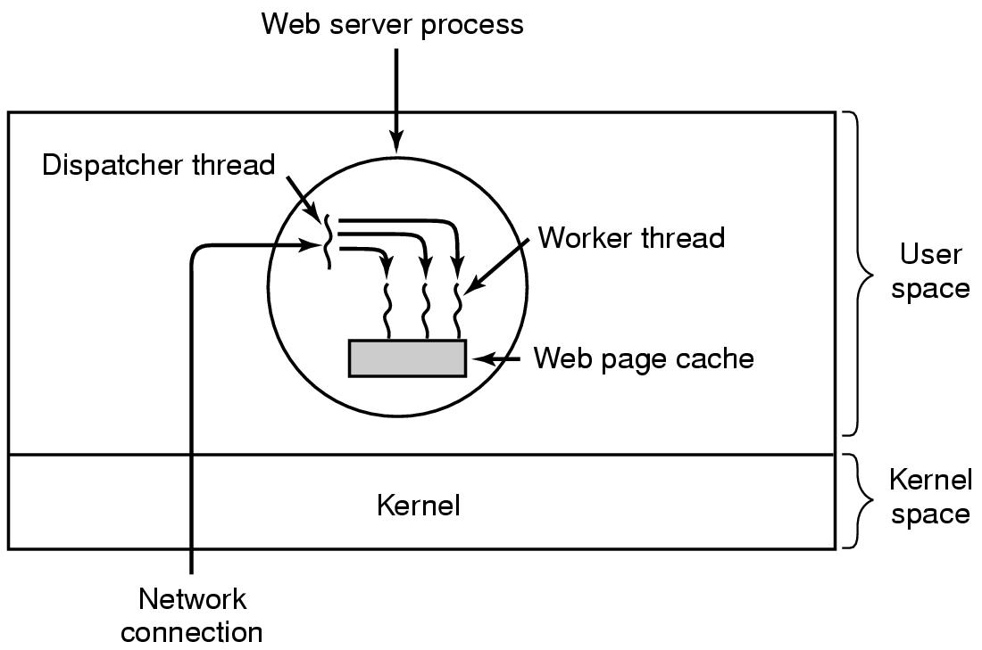
Thread Usage Example (2)
A multithreaded Web server

Slide 17
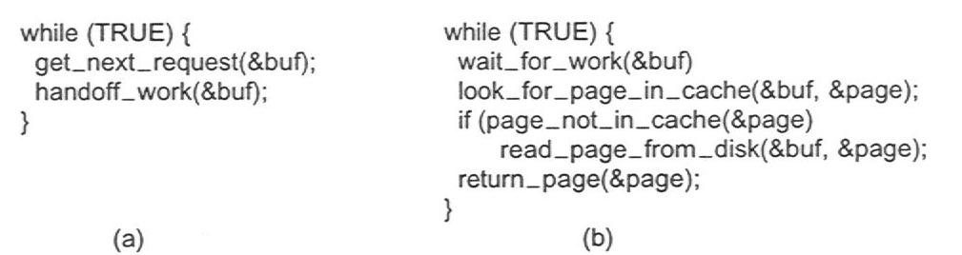
Thread Usage Example (3)
Dispatcher
(a) Dispatcher thread
(b) Worker thread
Notes:
Note: better to use pseudocode instead of C.

Slide 18
Threads as Processes Sharing Memory
Process can be viewed as the address space
Thread == program counter / stream of instructions
Two examples
Three processes, each with one thread
One process with three threads
Process 1
Process 2
Process 3
Process 1
User space
Threads
Threads
System space
Kernel
Kernel

Slide 19
Process & Thread Information
Per process items
Address space
Open files
Child processes
Signals & handlers
Accounting info
Global variables
Per thread items
Program counter
Registers
Stack & stack pointer
State
Per thread items
Program counter
Registers
Stack & stack pointer
State
Per thread items
Program counter
Registers
Stack & stack pointer
State

Slide 20
Threads & Stacks
Thread 1
Thread 2
Thread 3
User space
Process
Thread 1’s stack
Thread 3’s stack
Thread 2’s stack
Kernel
=> Each thread has its own stack!

Slide 21
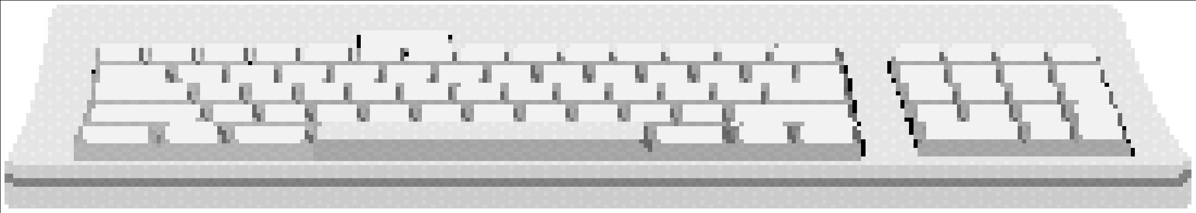
Why use threads?
Allow a single application to do many things at once
Simpler programming model
Less waiting
Threads are faster to create or destroy
No separate address space
Overlap computation and I/O
Could be done without threads, but it’s harder
Example: word processor
Thread to handle input
Thread to format document
Thread to write to disk
When in the Course of human events, it becomes necessary for one people to dissolve the political bands which have connected them with another, and to assume among the powers of the earth, the separate and equal station to which the Laws of Nature and of Nature's God entitle them, a decent respect to the opinions of mankind requires that they should declare the causes which impel them to the separation.
We hold these truths to be self-evident, that all men are created equal, that they are endowed by their Creator with certain unalienable Rights, that among these are Life, Liberty and the pursuit of Happiness.--That to secure these rights, Governments are instituted among Men, deriving their just powers from the consent of the governed, --That whenever any Form of Government becomes
destructive of these ends, it is the Right of the People to alter or to abolish it, and to institute new Government, laying its foundation on such principles and organizing its powers in such form, as to them shall seem most likely to effect their Safety and Happiness. Prudence, indeed, will dictate that Governments long established should not be changed for light and transient causes; and accordingly all
Kernel

Slide 22
Multithreaded Web server
Dispatcher thread
while(TRUE) { getNextRequest(&buf); handoffWork(&buf);
}
Worker thread
while(TRUE) { waitForWork(&buf); lookForPageInCache(&buf,&page); if(pageNotInCache(&page)) { readPageFromDisk(&buf,&page); } returnPage(&page);
}
Kernel
Web page cache
Network connection

Slide 23
Three ways to build a server
Thread model
Parallelism
Blocking system calls
Single-threaded process: slow, but easier to do
No parallelism
Blocking system calls
Finite-state machine
Each activity has its own state
States change when system calls complete or interrupts occur
Parallelism
Nonblocking system calls
Interrupts

Slide 24
Implementing threads
Process
Thread
Kernel
Kernel
Run-time system
Thread table
Process table
Process table
Thread table
User-level threads
+ No need for kernel support
- May be slower than kernel threads
Harder to do non-blocking I/O
Kernel-level threads
+ More flexible scheduling
+ Non-blocking I/O
Not portable (system dependent)

Slide 25

Concurrency Example: Multi-threaded Word Processor
In a multi-threaded word processor:
When the first thread is reading the next segment from the file, the second thread formats the text, and the third thread is waiting for the user input.
The shared resource is CPU time

Slide 26
Time to apply
Follow the instructions for exercise Week 3: A

Slide 27
Process / Thread: Memory

Slide 28
Process Memory Organization
A process needs memory space to store
Its code
The global constant values
Temporary values
Dynamically allocated variables
Etc.
The memory segments used by a process is organized based on the their utilizations.
[These segments are not necessarily contiguous in memory but for simplicity we assume so here]

Slide 29
Process Memory Organization
0
text
data
bss
heap
0xffffffff
stack
N.B.: this is a model, not all the implementations correspond literally on the specific fields or name, but represent very well the organization concept (example x86 stack is normally getting toward zero in others the opposite).

Slide 30
Process Memory Organization: text
Includes program code and constant
binary form (executable commands)
loaded libraries
known as “text” segment
space calculated at compile-time
0
text
0xffffffff

Slide 31
Process Memory Organization: data
Data: initialized global data in the program
Ex: int size = 100;
BSS*: un-initialized global data in the program
Ex: int length;
0
text
data
bss
0xffffffff
*BSS:block started by symbol (old name derivative)
Notes:
bss: block started by symbol (old name derivative)

Slide 32
Process Memory Organization: heap
Heap: dynamically-allocated spaces
Ex: MyArray = new int[100]
OS knows nothing about its
space
content
dynamically grows as program runs
0
text
data
bss
heap
0xffffffff

Slide 33
Process Memory Organization: stack
Stack: local variables in functions
support function call/return and recursive functions
grows to low address (upward in the figure)
0
text
data
bss
heap
0xffffffff
stack

Slide 34
Multi-threaded programs

Slide 35
HOW TO: first of all... logic
Always first, implement a sequential version of your target program:
Be sure the logic of your algorithm is correct.
Check with several test cases
Decide which piece of the program can be executed concurrently:
Refactor: re-implement the piece in an independent executable unit
Class, Function, Computational Expressions, etc.

Slide 36
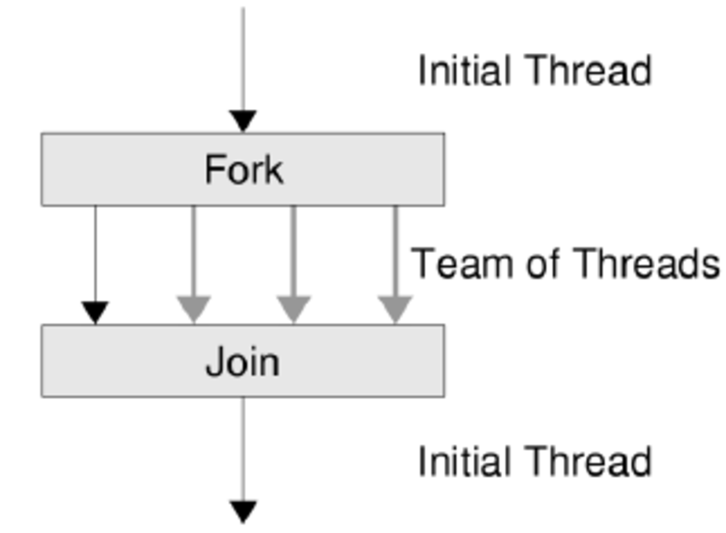
Multi-threaded constructs
Check
what kind of constructs you need
(example Class Thread)
how to specify the task of the thread
how to start the thread
how to wait for a thread
how can you put the thread to sleep
Watch here (first 5 minutes, https://www.youtube.com/watch?v=hOVSKuFTUiI )
Notes:
The first five minutes of this video is very helpful for the practical programming example:
https://www.youtube.com/watch?v=hOVSKuFTUiI

Slide 37
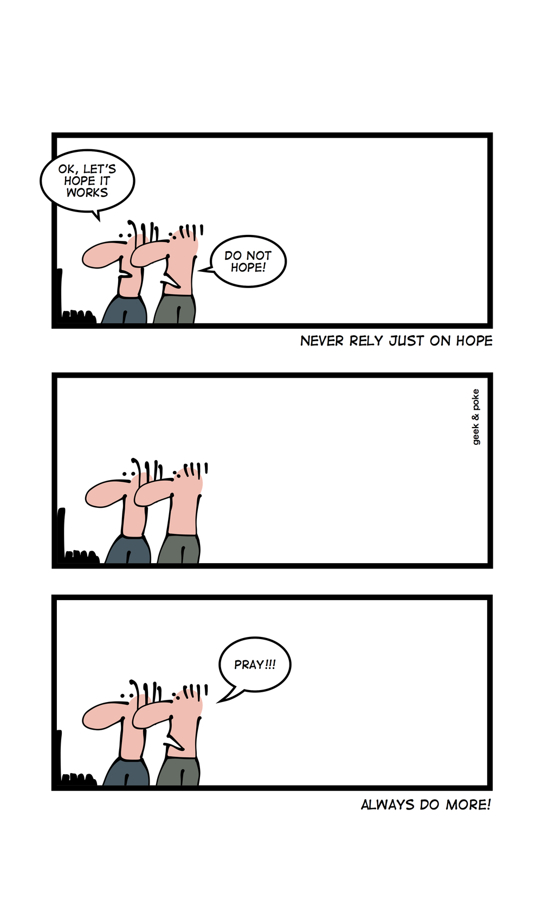
Time to apply
Follow the instructions for exercise Week 3: B and C.

Slide 38
Communication Models

Slide 39
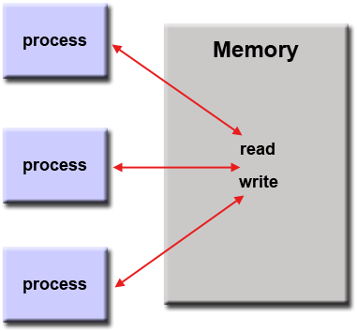
Communications between threads
Concurrent threads can communicate through a shared resource:
A piece of memory where they can write / read their messages.
Sharing resources in concurrency can be done through different ways.

Slide 40
Communications between threads
The most common ways of sharing resources are:
Shared memory: Parts of the main memory is shared between processes/threads
Message Passing: Processes/threads inform each other about the results of their tasks by communicating messages

Slide 41
Shared Memory with Threads
The concurrency model with shared memory is assumed to have multiple explicit threads
Traditional View: A running program (process) has:
One program counter (the current statement that is executing)
One call stack (each stack frame holding local variables)
Objects in the heap created by memory allocation (i.e., new) (same name, but no relation to the heap data structure)
Static fields in the class shared among objects

Slide 42
Traditional View: Single-Threaded
Call stack with local variables
Program counter for current statement
Local variables are primitives or heap references
pc=…
…
…
Heap for all objects and static fields

Slide 43
New View: Multi-Threads
New view:
A set of threads, each with a program counter and call stack but no access to another thread’s local variables
Threads can share objects and static fields
Communication among threads occurs via:
writing values to a shared location to be read by another thread

Slide 44
New View: Multi-Threads & Shared Memory
Threads, each with own unshared call stack and "program counter"
pc=…
…
…
pc=…
pc=…
…
Heap for all objects and static fields, shared by all threads
…

Slide 45
Time to apply
Follow the instructions for exercise Week 3: D.

Slide 46
Message Passing
Shared-memory communication is not very effective in some concurrent programming models.
For example, the standard programming model of Unix (Linux, etc.) was based on processes rather than threads.
The major difference is that processes do not share any state.
Instead we can take the other major approach to manage concurrency, called message-passing.

Slide 47
Message Passing Mechanisms
Two primary mechanisms are needed in a message-passing system:
A method of creating and specifying communication channels
A method of sending and receiving messages

Slide 48
Channel Specification
Direct naming
Simple but less powerful
Not suitable for specification of server-client systems
Example: Pipes
Port naming
Server use a single port to receive client request
Simple, suitable for single server, multiple client systems
Global naming (mailbox)
Suitable for multiple server, multiple client systems

Slide 49
Summary
Threads
Process / Thread: Memory
Multi-threaded programs
Communication models (we will continue this next week)
Message passing
Shared memory
...

Slide 50
Quiz time!
Head to classroom… You know the drill.

Slide 51
Time to apply
Follow the instructions for exercise Week 3: E and F (Optional).

